Slide 1
Mobile Display Measurement System User Guide (Android)
Host System Example: Windows 7 64-bits with Matlab R2012a
Mobile Device Example: Samsung Galaxy S3 (Android 4.1.1)
12/10/2012

Slide 2
System Requirement
Mobile Display Measurement System
Pattern Stream
Wifi Hub/Switch
Host System
TCP/IP Pattern Stream Program (Matlab)
APK
CS2000
CS2000 Measurement
Control Program (Matlab)
Ethernet Router
Mobile
Display
Test Pattern Folder
Instrument Requirement List
Host System (Including Matlab)
Ethernet Router
Wifi Hub/Switch
KONICA MINOLTA CS2000

Slide 3
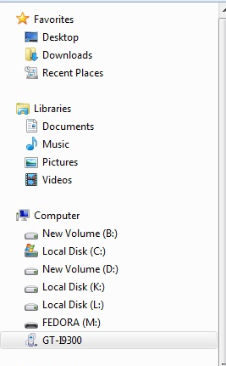
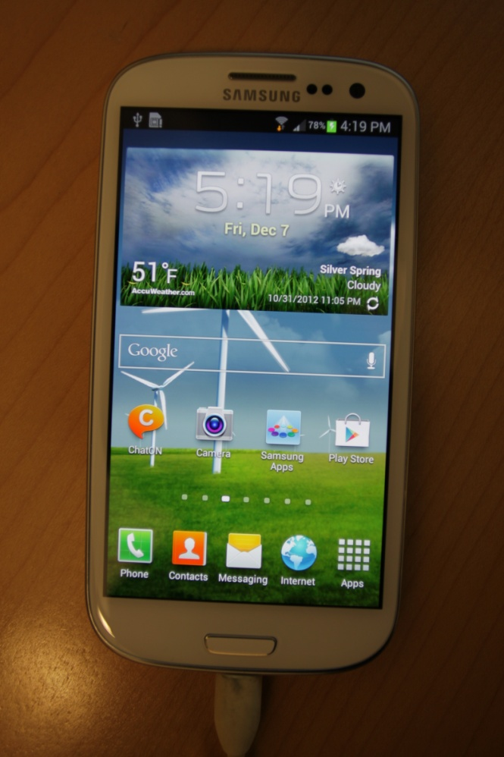
Mobile Device Software Installation
2. Find mobile device Item, and Click it.
1. Connect Mobile system to the host system

Slide 4
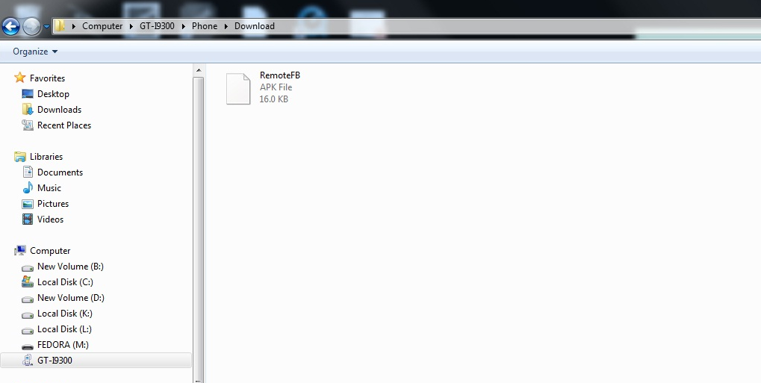
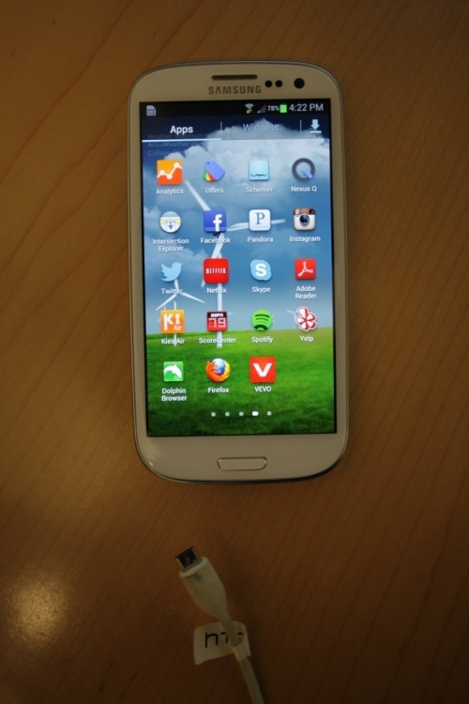
Mobile Device Software Installation (cont’)
3. Copy the control program “RemotFB.apk”into “GT-I9300/Phone/Download/” folder
4. Disconnect Mobile and host System

Slide 5
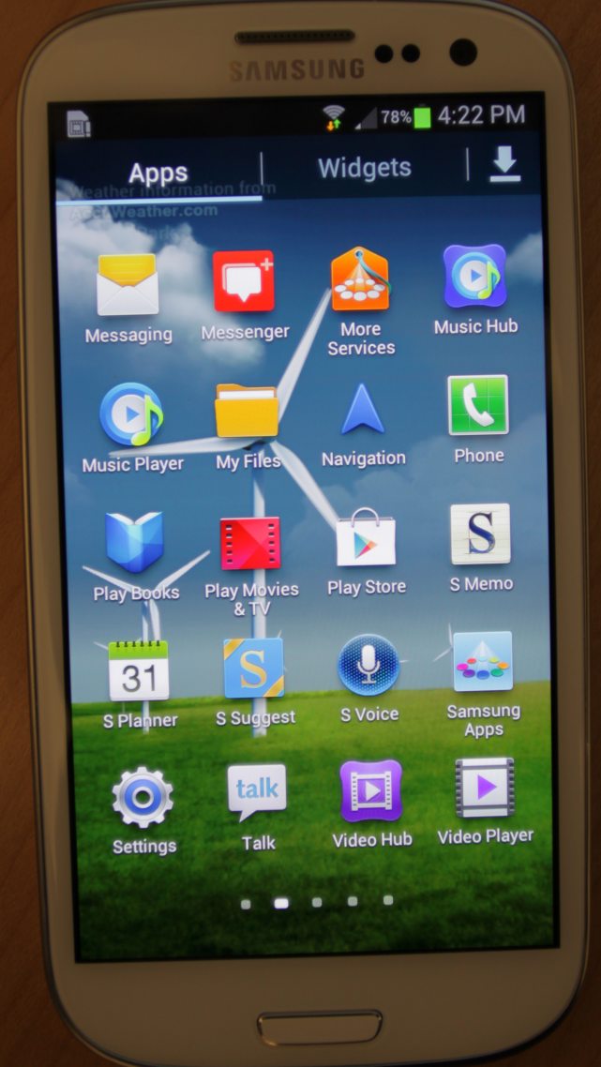
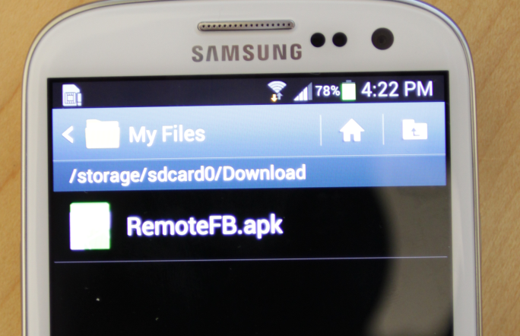
Mobile Device Software Installation (cont’)
5. Click My Files, and into the “Download/” folder

Slide 6
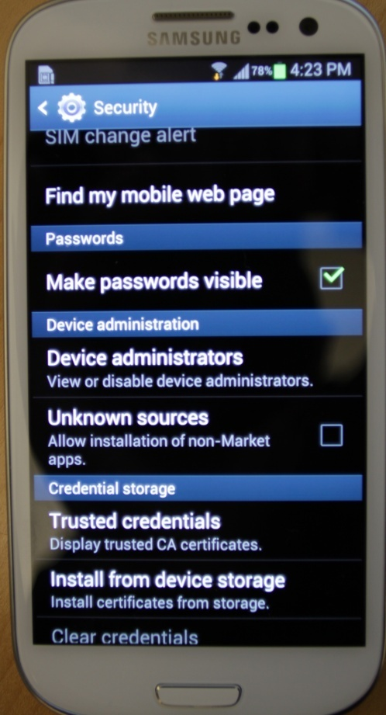
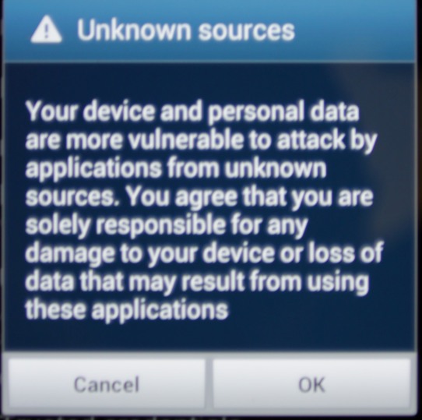
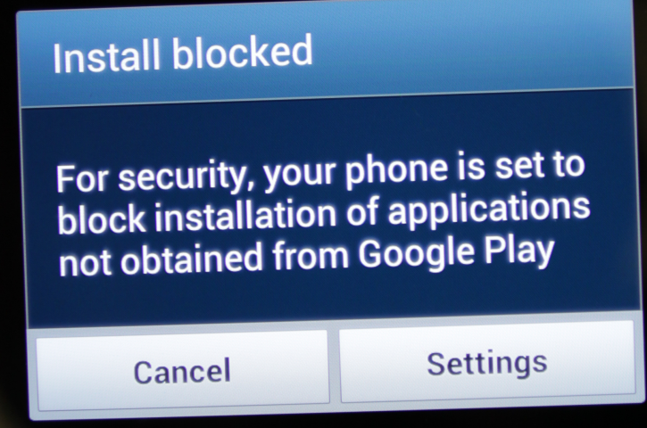
Mobile Device Software Installation (cont’)
6. Click “RemoteFB.apk”
6.b Please select “Unknown Sources”
6.a* If you see this dialog box, Please click “Settings” bottom
6.c Please click ok to accept install unknown sources
* If you don’t see any information about install blocked, please skip this page.

Slide 7
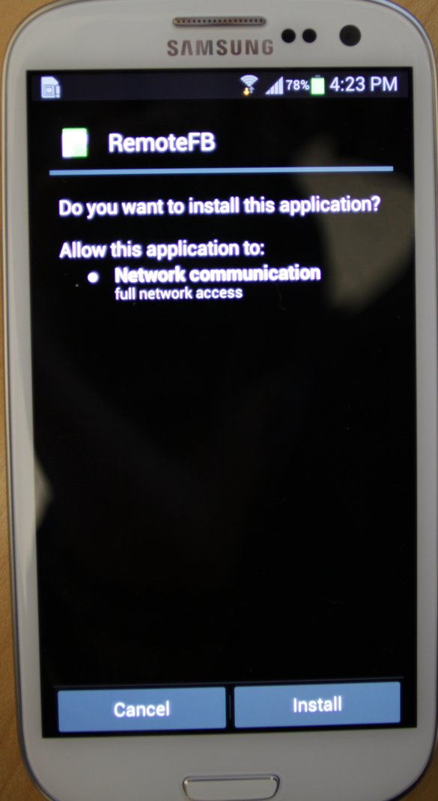
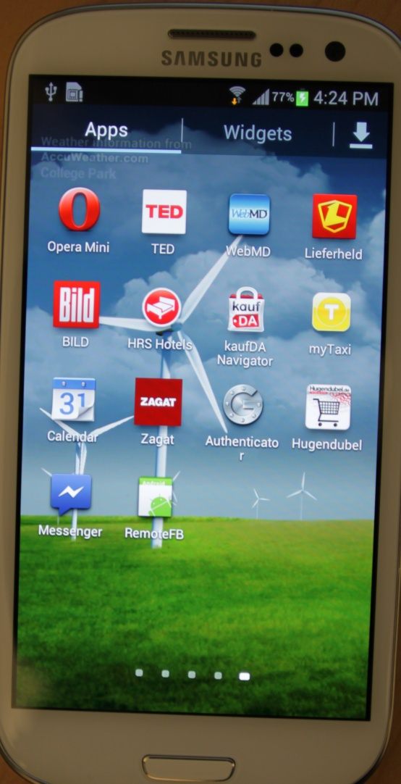
Mobile Device Software Installation (cont’)
8. If install successfully, you will see the App “RemoteFB”
7. Click the “Install”

Slide 8
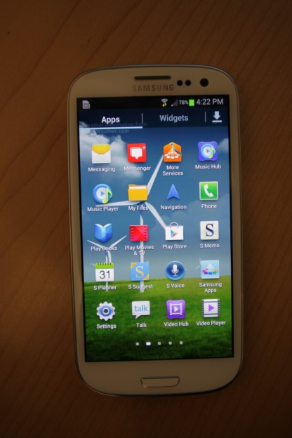
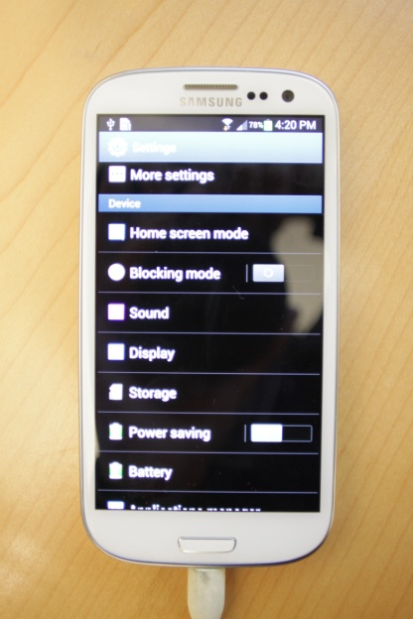
Mobile System Measurement Setup
1. Find Setting App, and Click it
2. Find Display Item, and Click it.

Slide 9
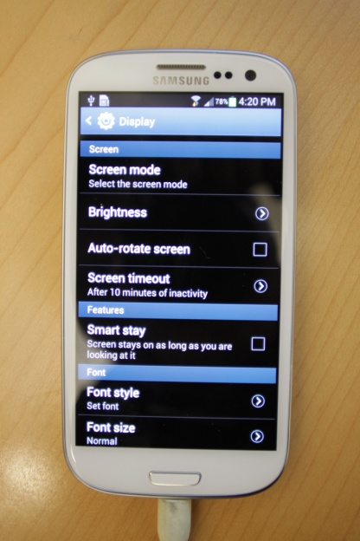
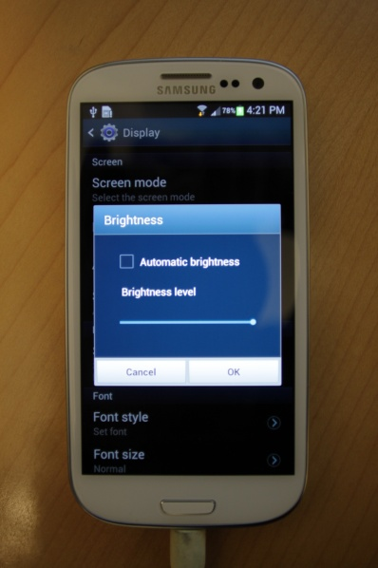
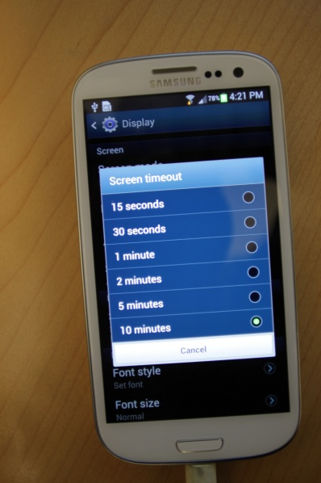
Mobile System Measurement Setting (cont’)
4. Brightness set to 25, 50, 75, or 100%.
3. Please set Screen timeout to 10 mins.
0%
25%
50%
75%
100%

Slide 10
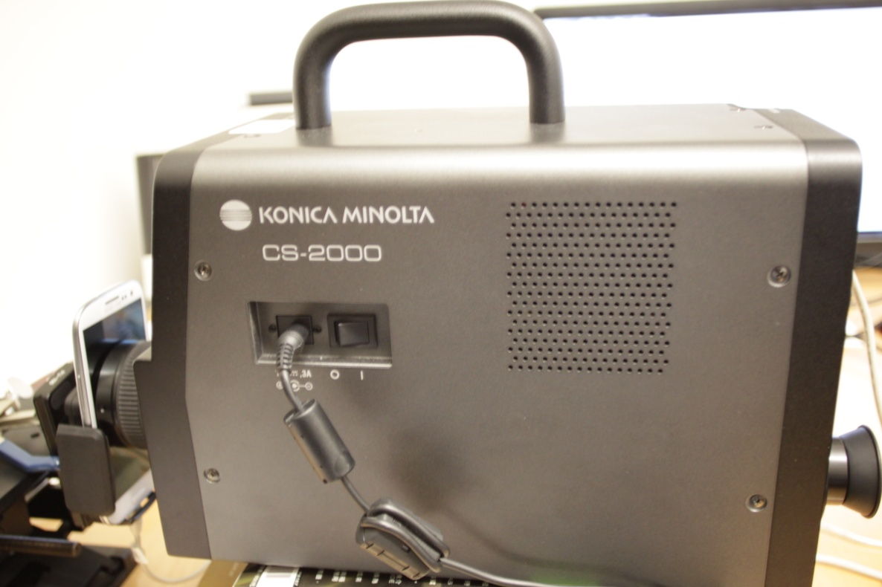
Mobile System Measurement Setting (cont’)
5. Connect KNOICA MINOLTA CS-2000 and target mobile device to the host system, prepare to measurement.

Slide 11
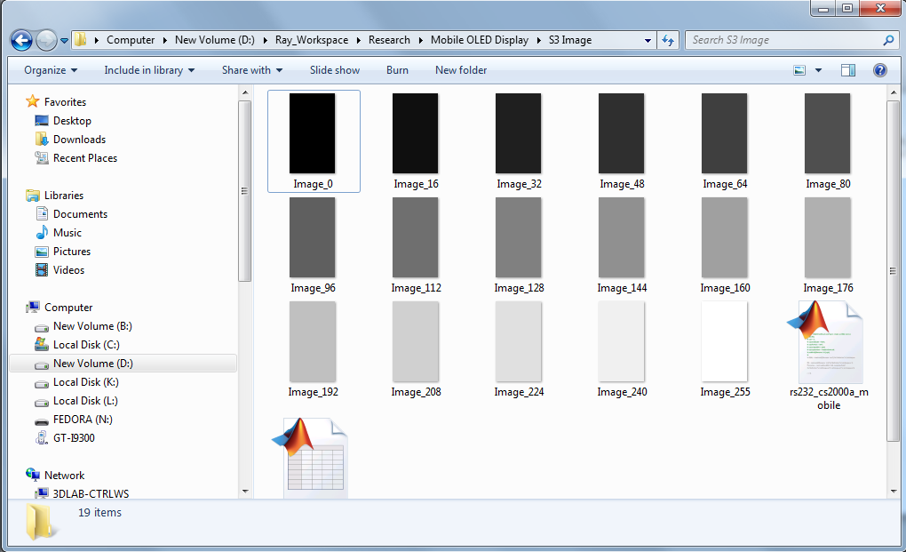
Host System Software Installation
1. Put all test patterns in the same folder
2. Please run the measurement program of “rs232_cs2000a_mobile.m”

Slide 12
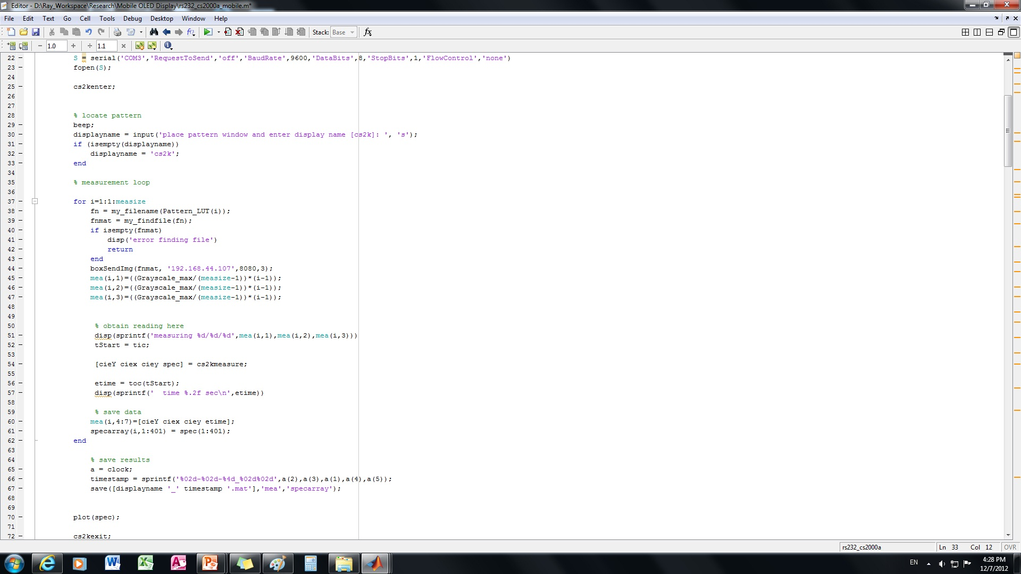
Host System Software Installation (cont’)
3. Find out the IP address of your android phone in settings->wireless & networks->WiFi settings->”Your WiFi network name”
4. In MATLAB, call the function boxSendImg(file, host, port, number_of_retries), in which file is the path of a image file, host is the IP address of your android phone, port is 8080

Slide 13
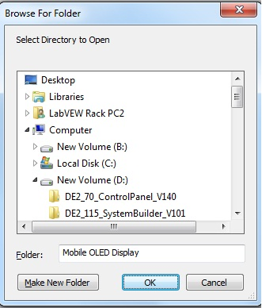
Host System Software Installation (cont’)
5. After you run the program, you will see this dialog box.
6. Select your test pattern folder, and press “ok”

Slide 14
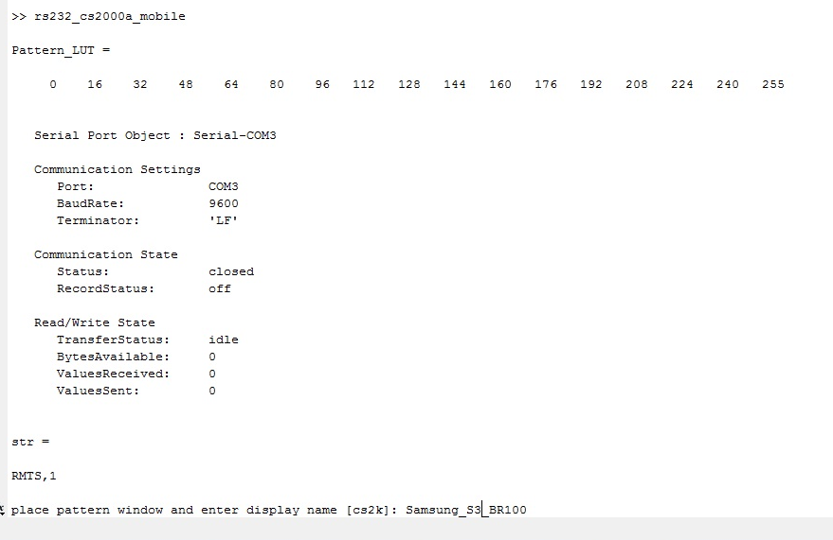
Host System Software Installation (cont’)
7. Select your record file name, and press enter to start the measurement

